Slide 1

CAPSTONE PROJECT Risk Analytic Model for Loan Applications
MORAS KASHYAP
GAYATHRI
AKSHAY
PAYAL
SHAHBAJ BEG
AUG 23, 2019
MENTOR –MR. VIKASH CHANDRA
PROJECT GROUP #6

Slide 2
LENDING CLUB ANALYSIS OVERVIEW
Identifying the Business Problem
Data Description
Data Preparation & Processing
Exploratory Data Analysis
Models
Logistic Regression
Random Forest
Gradient Boosting
Adaboost
Summary of Findings
Conclusion
Notes:
During this presentation we will move systematically through a discussion of our project. First we will give an overview of Lending Club model and the business problem that we are attempting to solve. Following this, we will briefly discuss details about our data set, how we prepared and processed the data to set up for our data mining exercise and a quick overview about our data mining approach itself. This will then be followed by a closer look at each of the four data mining methodologies we applied on the data. We will then wrap up by presenting a summary of findings followed by our conclusion of which of the data mining methodologies scored best in terms of predictive capability and what the model of choice told us about the data set itself

Slide 3
IDENTIFYING THE BUSINESS PROBLEM
Lending Club is a Peer-to-Peer lending company that utilizes a group of private investors to fund loan requests.
Lending Club’s model for risk assessment categorizes borrowers by assigning them a grade based on their credit score.
Investors are presented with a list of borrowers, along with their assigned risk assessment grades, and they have the opportunity to choose which borrowers they will fund, and the percentage of funding that they will cover.
Our business problem is to develop the credit score-card using machine learning models to predict the probability of default for a potential loan to be given to the new loan applications from the borrowers and suggest the interest rate based on risk categorization or risk bucketing.
Borrower
Lending Club
Investors
Notes:
Lending Club is an online peer to peer credit marketplace which matches borrowers and investors. For evaluating the credit-worthiness of their borrowers, Lending Club primarily relies on a grade and sub-grade it assigns them based on their credit-history. This rating information is then made available to investors who fund the loan requests, so that the investors can decide which loan request and how much of that loan request they will fund. In addition to the grade information, Lending Club provides historical loan performance data to investors for more comprehensive analysis. Our business problem is to find a model that will utilize the historic loan data to help better identify borrowers that are likely to default Such a model would allow investors to avoid loan defaults thus limiting the risk of their investments.

Slide 4
DATA DESCRIPTION
Lending Club provided us with 4 years of historical data (2007-2011).
This dataset contained information pertaining to the borrower’s past credit history and Lending Club loan information.
The dataset consist of 42538 records and 144 variables, which was sufficient for our team to conduct analysis models.
Notes:
Lending Club provides multiple years of good quality historical loan data. We accessed over 800000 loan records compiled over a period of 4 years from 2012 through 2015. Each record represented an individual loan. These records were comprised of over 100 variables. Included in the data set was a variable that stored information as to whether that particular loan record had gone into default or had stayed current through its repayment term. We could clearly see that this variable would be our dependent variable and that we would evaluate the other relevant variables to see what influence they had over it. Thus we began our next step of evaluating the data set and cleaning and preparing it for our data mining exercise.

Slide 5
DATA PREPARATION & PROCESSING
Prior to data model analysis, the data was reviewed, cleaned and prepared as follows:
Removed columns that obviously had no relation to the analysis in question (E.g. loan ID, Employee Title etc.)
Removed variables that had more than 90% missing values.
Grouped the ‘addr_state’ columns into region wise.
Grouped the ‘emp_length’ columns into experience wise.
Converted continuous variables to range of values to enhance interpretation of results (E.g. loan_amt, int_rate, Annual_income, credit_history_years, revol_util, total_pymnt etc.)
Notes:
Though the data was of good quality, we found that we had to perform some clean-up activity. We discarded variables that were redundant or obviously did not exert any influence on the dependent variable (For example: Employee ID, Borrower job title, and the credit history URL). We then removed observations that were missing data in key variables. This, however, was very small percentage of the population. Once we had trimmed the variables and record set, we converted certain continuous variables into ranges of values that would allow for a better interpretation of the results. For example, we categorized loan amounts into 10 ranges of values as we found that a loan value of say $10,000 and $10,100 did not provide any discernable difference. Finally, we converted the variable called loan status into a binary variable called “default” for use as our dependent variable.

Slide 6
CHALLENGES
One of main challenge faced by us was many of the features were in object type that had to
be converted to numeric type using get dummies for extracting outputs.
Multi-collinearity test was done with VIF as 5 and features having below 5 was considered.
For the classification since the output was imbalanced, we did oversampling using SMOTE to make it balanced.

Slide 7
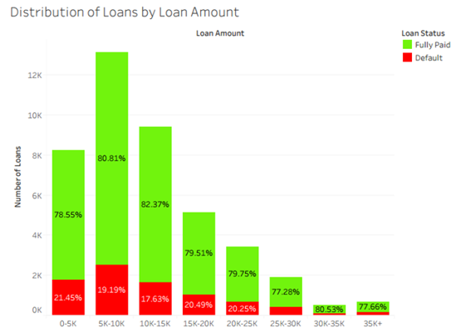
Exploratory Data Analysis
Graph indicates that
Most of the loan has sanctioned between the
range in 5k and 15k.

Slide 8
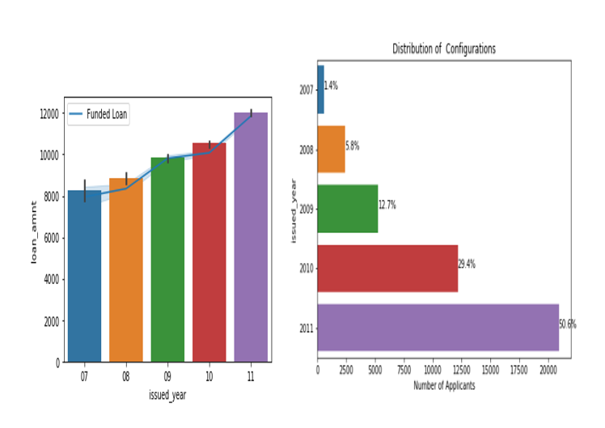
Exploratory Data Analysis (cont.)
From the below graph we can infer that the number of loan applicants where increasing twice the previous year.
2011 have the highest number of loans.

Slide 9
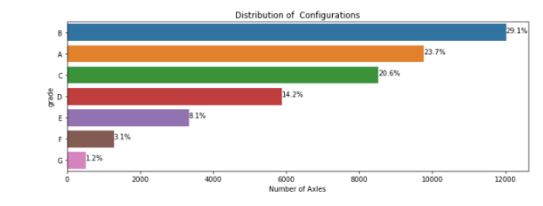
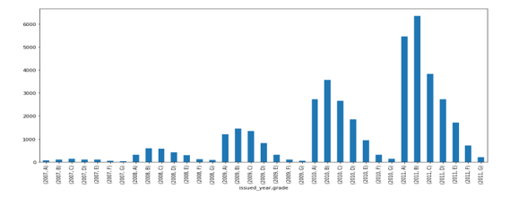
Exploratory Data Analysis (cont.)
1.The interest rates are increasing linearly with time.
2.We can infer that the applicants with grade b - interest ranging from 7%-10% where more in number

Slide 10
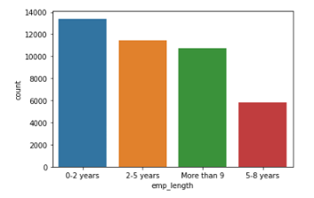
Exploratory Data Analysis (cont.)
People will less experience have is the highest number of borrowers because of personal/education loans.
People with more than 9 years are highest comparatively than people ranging from 5-8years home loan/financial conditions/consolidate loans

Slide 11
Exploratory Data Analysis (cont.)
Year wise comparison of Good and bad loans
The variable “loan status” has two classes:
Fully paid
Charged Off
Fully paid can be categorized under “Good loans”
and charged off can be categorized under “Bad loans”
There is a gradual decrease in the percent of bad loans
from 2007, but there is an increase again in 2009
Issue date in Year | Loan Status | Percentage
2007 | Good loans Bad loans | 72.74% 27.25%
2008 | Good loans Bad loans | 79.07% 20.92%
2009 | Good loans Bad loans | 88.11% 11.88%
2010 | Good loans Bad loans | 85.55% 12.44%
2011 | Good loans Bad loans | 86.67% 13.32%

Slide 12
MODELS
LOGISTIC REGRESSION
RANDOM FOREST
GRADIENT BOOSTING
ADABOOST
We selected four data models to determine which returned the best predictive capability. We utilized multiple assessment parameters to determine the most successful model, to include:
Confusion Matrix (Accuracy, Sensitivity and Specificity)
Receiver Operating Characteristic (ROC)
Notes:
We selected four data mining methodologies for our analysis, namely, Logistic Regression, Decision Tree, k-Nearest Neighbor and Neural networks. These are common dependency techniques used in data mining and are very well supported by commercial-off-the-shelf applications like the SAS Institute’s JMP Application for quick and effective data mining analysis. In addition to selecting the methodologies, we established the parameters that we were going to use for comparing these four models at the end of the data mining exercise. These parameters as listed in this slide primarily originate from the Confusion Matrix, ROC and Lift Charts and the fit measures of the models. We were specifically planning to watch for higher values of Sensitivity, Area-under-curve value from the ROC Curve and R-Squared values from the fit-measures for our comparison. We would also look for smaller values of Log likelihood, RMSE, Mean Abs Dev and Misclassification Rate. After each model was run and analyzed to determine the optimal settings, the final model was run and the predictive formulas were saved to the table for later comparison.

Slide 13
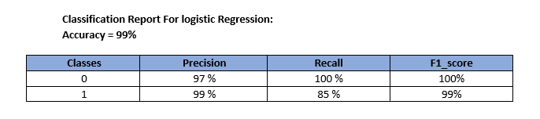
LOGISTIC REGRESSION
We selected the binary variable of default for the target variable and ran the model utilizing the remaining continuous variables; assessing the model utilizing Confusion Matrix( Precision, Recall and F1_score).
We were successful in converting a number of variables, while maintaining a 99% accuracy rate..
Notes:
As part of our Logistic regression analysis, we performed Multi-variate and Bi-variate analysis to confirm that the variables we had selected for the data mining exercises exhibited reasonably strong correlation. We used the P-value of <0.0001 for this evaluation. Following this, we ran the Logistic regression and ascertained that the whole model test showed a R-Square value of 48%, indicating reasonably strong influence of the independent variables over the dependent variable. From the confusion matrix, we ascertained an accuracy level of 93%. We also evaluated the linearity of Logit to confirm that any continuous variables in our data set had a linear relationship between them.

Slide 14
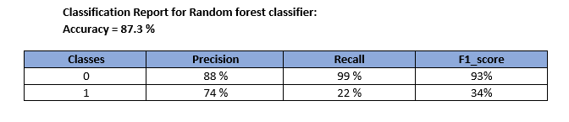
RANDOM FOREST
Building model using Random Forest Classifier
Random forest, like its name implies, consists of a large number of individual decision trees that operate as an ensemble. Each individual tree in the random forest spits out a class prediction and the class with the most votes becomes our model’s prediction
Notes:
For the decision tree, we tried two approaches. First we had the JMP application perform an automatic recursive split and JMP arrived at an optimal 142 splits with an R-square value of 0.52. In order to confirm this, we then performed a manual iterative split and found that when we reached 58 splits, we were able to achieve an R-square value of 0.5, with further splits yielding no discernable improvement to the R-square value. Hence, we decided that we would go with 58 splits for our decision tree analysis. As you can see on this slide the fit measures support our decision of selecting 58 splits over 142 splits.

Slide 15
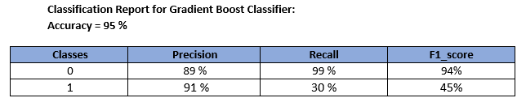
GRADIENT BOOSTING
Building model using Gradient Boost Classifier
Gradient boosting is a machine learning technique for regression and classification problems, which produces a prediction model in the form of an ensemble of weak prediction models, typically decision trees.

Slide 16
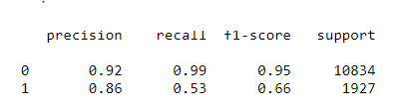
ADABOOST
Building model using AdaBoost Classifier
Adaboost is a machine learning technique for regression and classification
problems, which produces a prediction model in the form of an ensemble of weak
prediction models, typically decision trees.

Slide 17
MODEL COMPARISON
We evaluated our models by retesting them with a selected subset of data, consisting of the same independent variables and a binary dependent variable. We compared their results using parameters: Confusion matrix, receiver operating characteristic (ROC,AUC)
CONFUSION MATRIX
Accuracy
Sensitivity
RECEIVER OPERATING CHARACTERISTIC (ROC)
Area Under Curve (AUC)
Specificity
Notes:
Before actually comparing the models, we re-confirmed the parameters that were going to be used for the comparison. These were the Accuracy, Sensitivity and Specificity values from the Confusion Matrix, the AUC value from the Receiver Operative Characteristic (or ROC) Curve, the R-Square, RMSE, Mean Abs Dev, Misclassification rate and Log Likelihood values from the Fit measures and finally, a visual verification of the Lift chart. As a guideline, higher values of Accuracy, Sensitivity, Specificity, AUC and R-Square are better. For Log likelihood, RMSE, Mean Abs Dev and Misclassification rate smaller values are better.

Slide 18
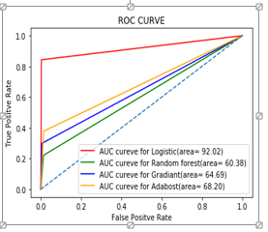
MODEL COMPARISON
Comparing all the classification models we can infer that logistic
regression is considered to be the best model to predict
probability of default loans.
Sometimes we may be willing to give up some improvement to
the model if that would increase the complexity much more than
the percentage change in the improvement to the evaluation
metrics.

Slide 19
CONCLUSION
As can be seen from the comparison results, the Logistic Regression model performed better than the other models in terms of Fit measures, Area-under-curve from the ROC & Confusion Matrix
Other notable findings through our analysis was that the independent variables relating to the total amount of payments that a borrower had made and the amount of the loan had the strongest relationship with the response variable. Throughout all analysis models, these two variables returned the highest degree of correlation to the response variable than any other model.
Recommendations:
Loans with term of 36 months tended to be defaulted a lot more than loans with term of 60 months. Choose loans with 60 month terms.
Notes:
Thus, we can see that the Decision tree model comes up with the best score for predictive capability as compared to the other three models for this particular data set. Logistic regression followed closely with comparable results. Neural networks rated high in most areas, with the exception of sensitivity, while k-nearest neighbor resulted in the lowest performance. Other significant findings were that independent variables relating to the total amount of payments that a borrower had made and the amount of the loan had the strongest relationship with the response variable.
From our data mining analysis we have the following recommendations for investors:
Take note of the requested loan amount. Although a higher loan principle equates to larger gains from interest, higher loan amounts also equates to a higher likelihood of default. We found that this risk of default increases exponentially for loan amounts over $9,000. Choose loans that $9000 or less.
A borrower that chooses a short term for the life of a loan implies that they are committed to paying off the debt as quickly as possible. It suggests that they have the means to handle the higher monthly payment. However, we have found that the shorter loan term had more defaults than the lengthier term. The longer term loan translates to borrowers having the ability to budget around the smaller monthly payment, and the investor benefiting from longer living cashflow on his investment. Choose loans with 60 month terms.
3) While lower subgrades equate to higher interest rates we found that they also significantly increase the likelihood of default. Selecting loans of subgrade B5 and higher will result in a 90% chance of repayment.

Slide 20
FUTURE SCOPE
Include more data from later years
More feature engineering
Create a web app that will take in parameters and output a credit risk probability

Slide 21
Thank You!
Notes:
This concludes our presentation. Thank you for taking the time to view it. We hope that you found the story that we unlocked from the Lending Club loan data to be informative and useful.

